Slide 1



THE ENTREPRENEURIAL PROCESS :
Identifying Opportunities
Planning
Seeking Feedback
Setting a Goal

Slide 2




PERSONAL INITIATIVE IN THE ENTREPRENEURIAL PROCESS
Your own initiative is necessary at all stages of the entrepreneurial process:
Identification of opportunities
Setting a goal
Planning
Seeking feedback
Notes:
Introduce at a later point in the training

Slide 3
INNOVATION AND OPPORTUNITY IDENTIFICATION
[ ]
Identifying opportunities
Planning
Seeking feedback
Setting a goal
Do something new that your competitors are not doing!

Slide 4

SELF-ASSESSMENT QUESTIONNAIRE "Innovation and and opportunity identification
WS 7
Read the self-assessment questionnaire on "innovation and opportunity identification" and tick the answers.

Slide 5



EVERY BUSINESS CAN AND SHOULD BE IMPROVED
To improve your business, you need to be innovative. Being innovative means creating ideas which are both new and useful.
There are 3 areas where you can be innovative to create opportunities
Innovation
is about :
The Product/Service
The Processes
Communication

Slide 6
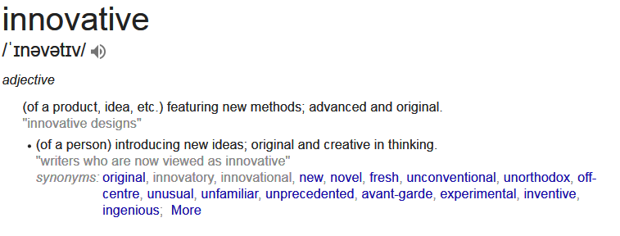
INNOVATIVE SOLUTIONS
That evening quail came and covered the camp, and in the morning there was a layer of dew around the camp. When the dew was gone, thin flakes like frost on the ground appeared on the desert floor. When the Israelites saw it, they said to each other, “What is it?” For they did not know what it was.
Moses said to them, “It is the bread the Lord has given you to eat.
Exodus 16: 13-15

Slide 7
THE IMPORTANCE OF INNOVATION
Do something new that your competitors are not doing!
Vital Importance: Never stand still - stay ahead of your competitors to help your business succeed
When competitors try to copy you, think of new ideas to ensure your business remains unique!
To be innovative you need to identify new business opportunities!

Slide 8
THE IMPORTANCE OF INNOVATION
EXERCISE
Instruction:
In groups of 4 identify why it’s so important to innovate in business using one example from all the three areas of innovation in any business:
The Product/Service
The Processes
Communication

Slide 9






Process of Opportunity Identification
own / others
problems
needs
EVALUATION
M
MARKET
CREATIVITY
BUSINESS IDEA
RESOURCES
ACTION!
skills and knowledge
creativity
financial
social

Slide 10
THE IMPORTANCE OF INNOVATION
EXERCISE
Instruction:
In groups of 4 identify how you can identify a business opportunty.
Include all forms of research you can think of as well as ways of coming up with ideas yourself.
This step is just about HOW you come up with an idea, don’t try to evaluate it, that comes at a later stage.

Slide 11



WHAT YOU NEED TO DO Be Creative
Self-Starting
Actively reasearch and brainstorm ideas, look at the needs in the market and where other solutions can be improved on
Avoid "me too" ideas unless you are offering something unique Generate NEW ideas!
Think outside the box. Don't let your current knowledge limit your thoughts
Future-Oriented
Avoid keeping things the same. Think about what might be needed in the future
Think of a way to record the creative ideas you want to pursue in the future
Overcoming Barriers
Don’t give up on ideas because you aren’t sure if they are feasible
Don’t allow tradition or convention to get in your way

Slide 12

EXERCISE I: Think Differently and Unconventionally
Instruction
Think of as many alternative uses of a brick as you can. Be creative!
Notes:
Get rid of this exercise
But keep in our repertoire (for specific tagret groups)
Replace with exercise on brainstorming (e.g. brick) instead.
We need brainstorming in terms on association.

Slide 13
DIFFERENT UNCONVENTIONAL
Shortly before dawn Jesus went out to them, walking on the lake.
Matthew 14: 25

Slide 14
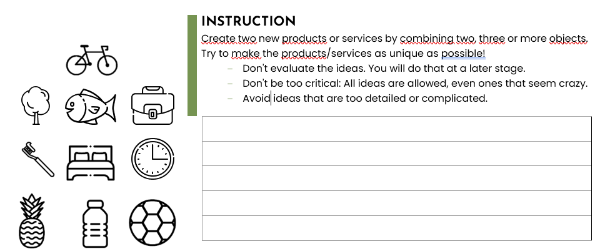






WS
8
EXERCISE II: Think Differently and Unconventionally
To avoid the seemingly obvious, you can combine different ideas.
Notes:
Maybe adapt symbols?
+ one with a link to sustainability?
+ let them create more than 1 new product

Slide 15
THE "SCAMPER" TECHNIQUE
S - Substitute
Can you replace part of the product/service?
C - Combine
Can you combine the product/service with another?
A - Adapt
Can you adapt the functionality of the product/service?
M - Modify
Can you change the size or attributes of the product/service?
P - Put to another use
Can you find other areas where the product/service has an alternative use?
E - Eliminate
Can you remove an element from the product/service?
R - Rearrange
Can you change the idea behind the product/service?

Slide 16
THE "SCAMPER" TECHNIQUE Example: A Notepad
S - Substitute
Replace paper with recycled materials or waterproof synthetic paper for durability and eco-friendliness.
C - Combine
Combine the notepad with a calendar and planner, integrating sections for scheduling and to-do lists.
A - Adapt
Adapt the notepad for specific professions, such as adding templates for designers, engineers, or chefs to cater to their unique needs.
M - Modify
Modify the cover design to be customizable with personal photos or artwork, appealing to individual tastes.
P – Put to another use
Repurpose the notepad as a sketchbook by using thicker, higher-quality paper suitable for drawing and painting.
E - Eliminate
Eliminate the need for a separate bookmark by integrating a ribbon or elastic band marker.
R - Rearrange
Rearrange the order of pages to include sections for different purposes (notes, tasks, ideas) within one notepad.

Slide 17
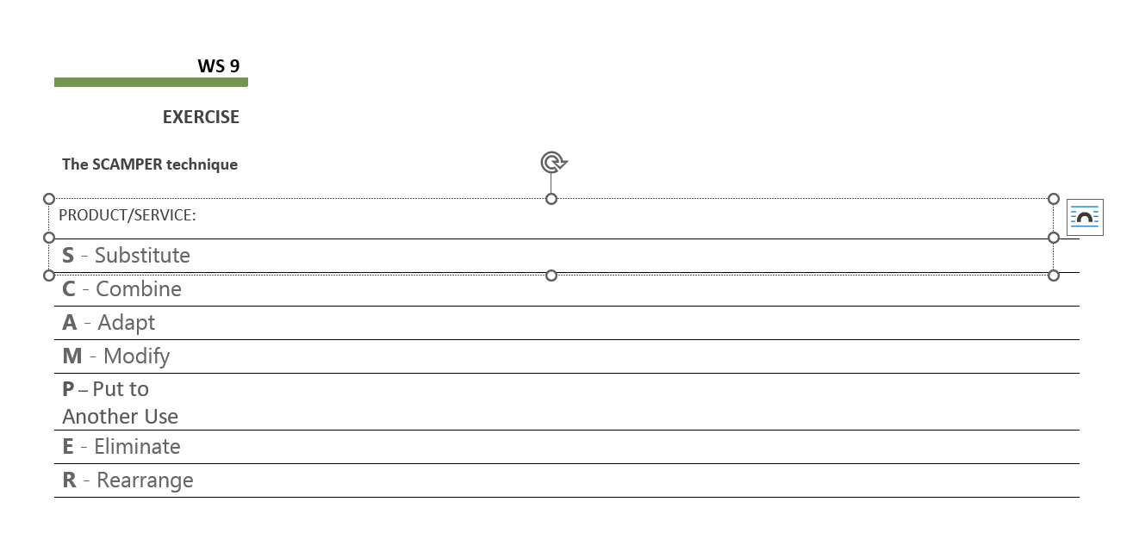
WS
9
EXERCISE III: Think Differently and Unconventionally
Instruction: Work in groups of two (02) and choose a product or service from one of your projects. Can you modify it using the SCAMPER technique?

